Slide 1
Collections & Exception Handling
(Week 5)
Name: Sheikh Thanbir Alam
Deg: Senior Software Programmer
Org: Army War Game Center, BD Army

Slide 2
Suggested IDE for C#
Visual Studio (Desktop/Laptop→Click to download)
Try Dot Net (Web→Click to view)
Dot Net Fiddle (Web→Click to view)

Slide 3
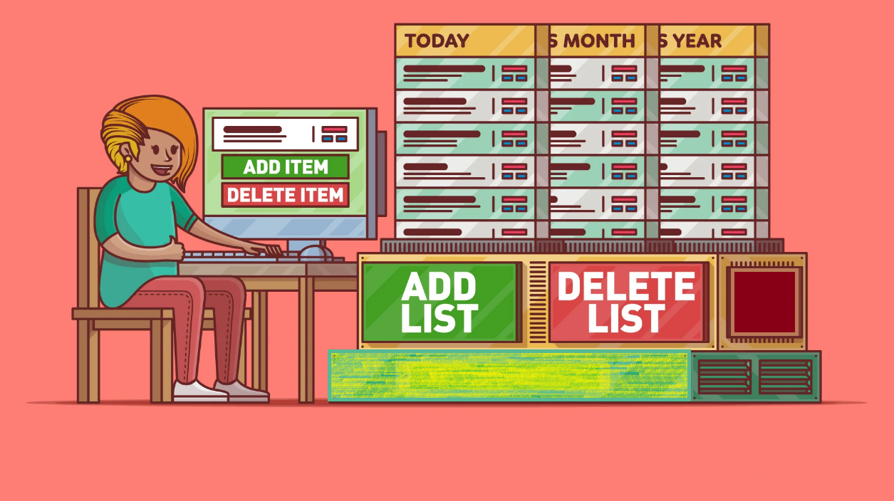
What is Collection?

Slide 4
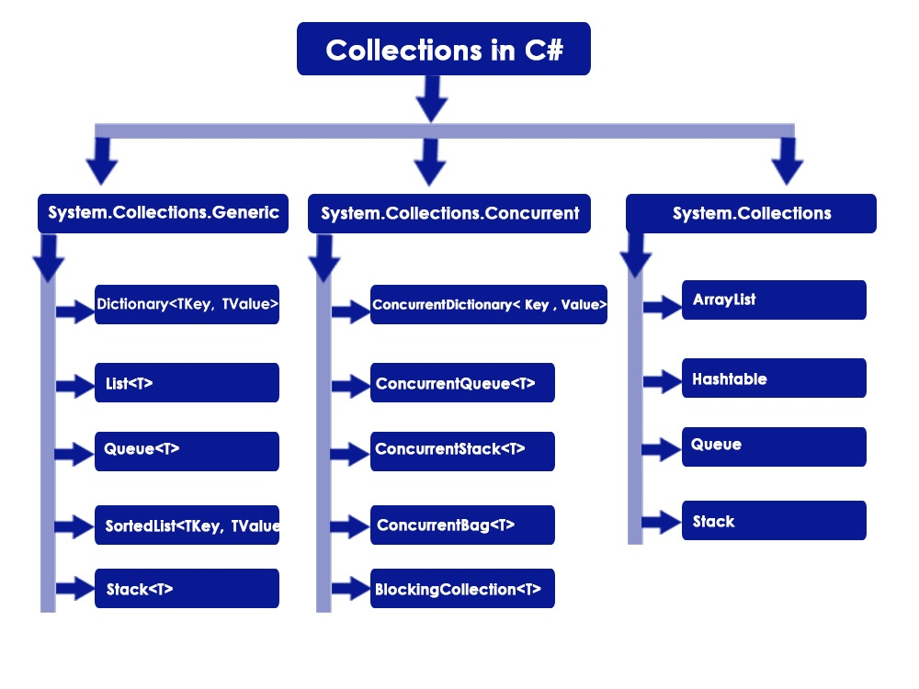
Types

Slide 5
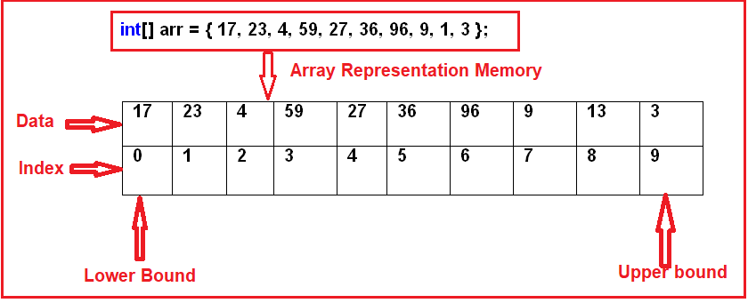
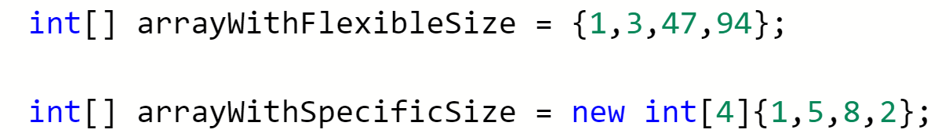
Array-1D

Slide 6
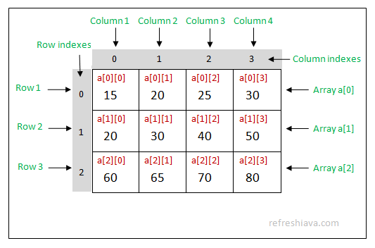
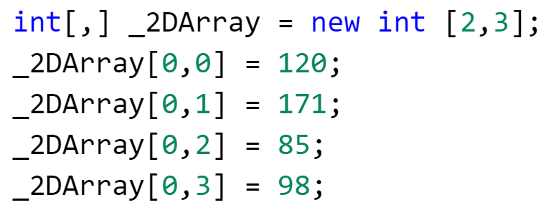
Array-2D

Slide 7
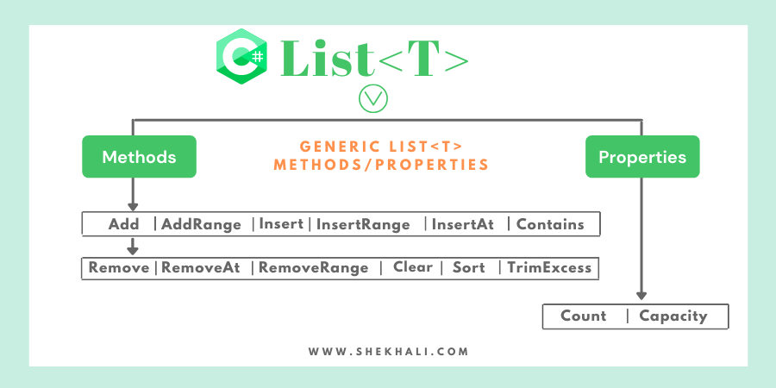
List

Slide 8
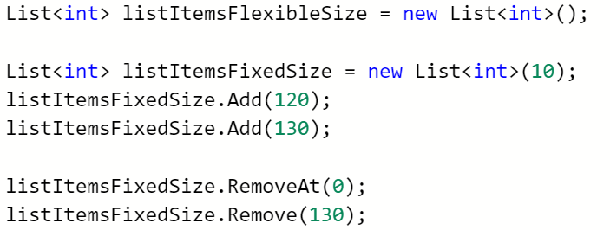
List

Slide 9

Garbage Collection

Slide 10
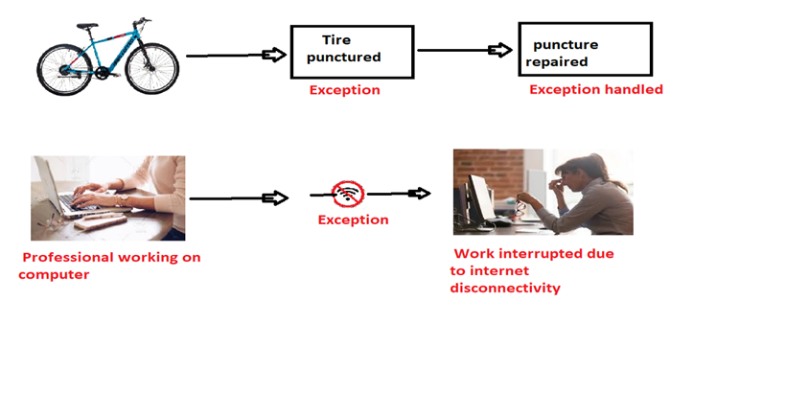
Exception Handling

Slide 11
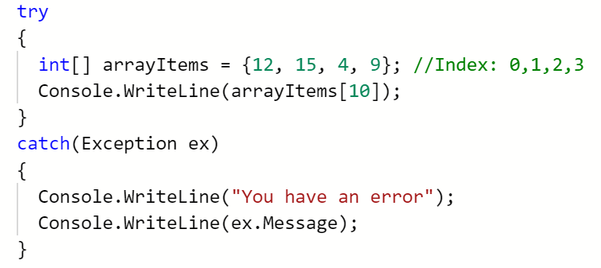
Example

Slide 12


